Slide 1
Topic 5: ANOVA and general linear models

Slide 2
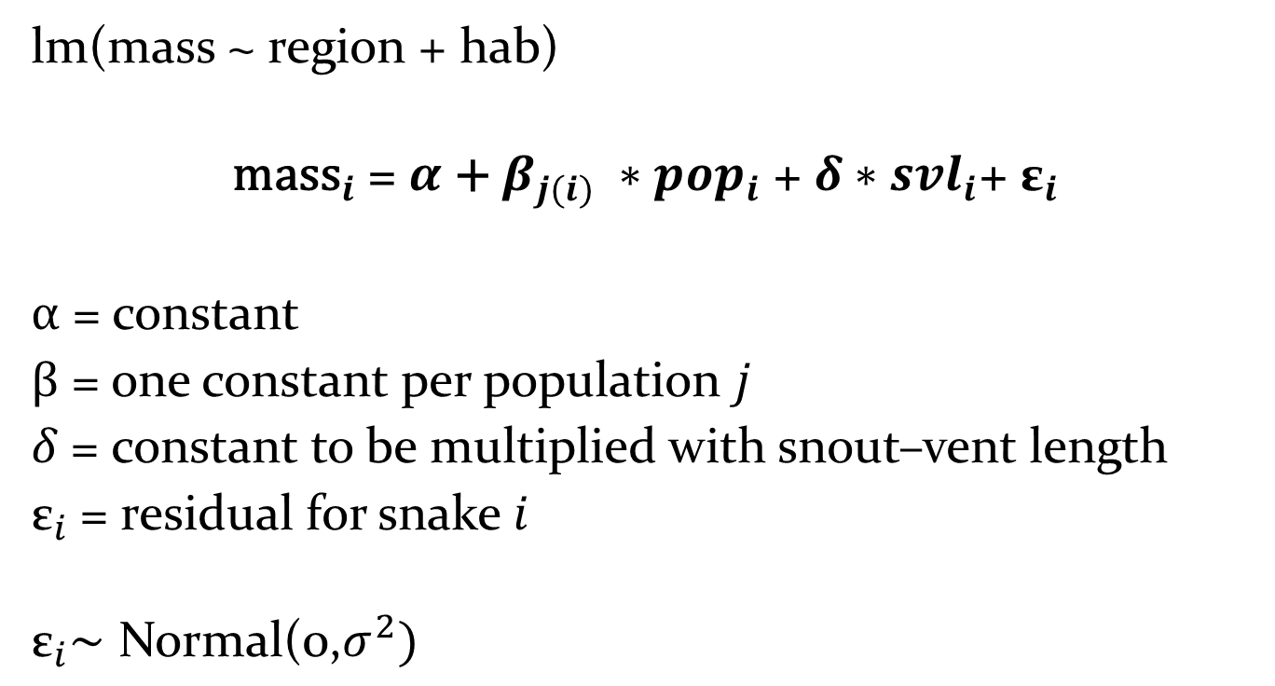
Example: Analysis of Covariance
lm(mass ~ region + hab)
$${\text{mass}}_{i}\text{ = }α\text{ + }β_{j(i)} ∗{pop}_{i} \text{+ }δ∗{svl}_{i}\text{+ }{\text{ε}}_{i}$$
$α\text{ =}$ constant
$β\text{ =}$ one constant per population $j$
$δ\text{ =}$ constant to be multiplied with snout–vent length
${\text{ε}}_{i}$= residual for snake $i$
$${\text{ε}}_{i}\text{∼ }\text{Normal}\text{(0,}σ^{2})$$

Slide 3
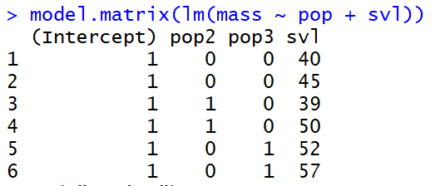
Example: Analysis of Covariance
$${\text{mass}}_{i}\text{ = }α\text{ + }β_{j(i)} ∗{pop}_{i} \text{+ }δ∗{svl}_{i}\text{+ }{\text{ε}}_{i}$$

Slide 4
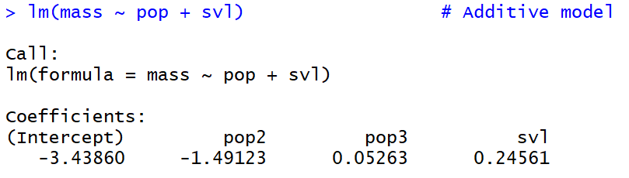
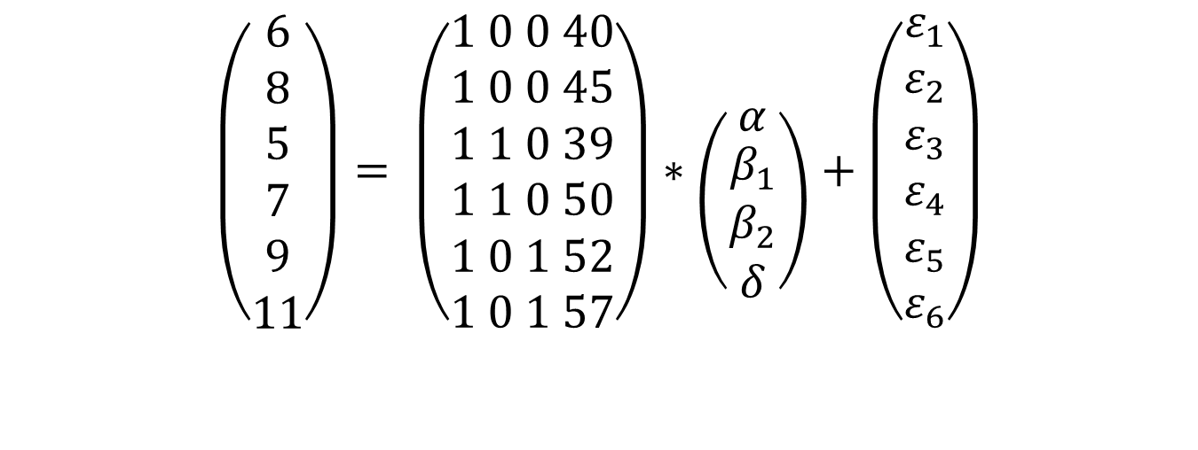
Example: Analysis of Covariance
$$\left(\begin{aligned}6 \\ 8 \\ 5 \\ 7 \\ 9 \\ 11\end{aligned}\right)= \left(\begin{aligned}1 0 0 40 \\ 1 0 0 45 \\ 1 1 0 39 \\ 1 1 0 50 \\ 1 0 1 52 \\ 1 0 1 57\end{aligned}\right)∗\left({α \atop \begin{aligned}β_{1} \\ β_{2} \\ δ\end{aligned}}\right)+\left(\begin{aligned}ε_{1} \\ ε_{2} \\ ε_{3} \\ ε_{4} \\ ε_{5} \\ ε_{6}\end{aligned}\right)$$

Slide 5
Exercise: General Linear Models
30 aspen trees
crownclass: 1=dominant; 2=codominant; 3=intermediate; 4=suppressed
age (years)
stem dbh (diameter outside bark measured at 1.3 m above ground, cm)
height (m) from ground to tree tip
stem volume per tree (m³).

